Slide 1
Hello Dragons:
my name is Claude LeBlanc
from Campbellton, New Brunswick.
I’m here to ask for $50,000 in exchange for 10% of my business.
I Am a 25 YEAR MEMBER OF THE professional golf association
(pga) OF Canada and a school teacher.

Slide 2
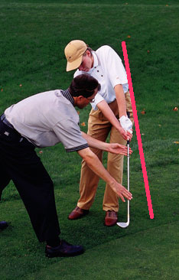
I HAVE been Teaching Golf for the better part of my adult life. it is a passion and A rewarding profession.
UNFORTUNATELY, FEWER people today are taking
golf lessons at facilities.
My Motto: LEARN FIRST AND PLAY LATER.
Knowledge is power.

Slide 3
Learning Golf:
According to an ONLINE reseaRch, people are taking FEWER golf lessons today because of the following:
1- Time (people have less time to travel to facilities for golf lessons);
2- Money (Cost for a lesson in Canada is between $40 to $125 per hour depending on the location); and
3- intimidated or afraid to APPROACH a PGA Professional FOR LESSONS.
approximately 3 to 10 lessons are given to students during THE Season.
If you were given 3 to 10 piano lessons, would you be considered a good piano PLAYER?
Learning golf is an ongoing process, But how are you going to receive this knowledge?
Searching online is predictable but finding a Step by Step program is quite a challenge.

Slide 4
the Market:
According to A STUDY made BY THE National Allied Golf AssociationS (NAGA),
• 6 million Canadians play golf each year;
• Golf is the number 1 recreational activity in Canada, played by more Canadians than hockey and soccer;
• 60 million rounds of golf were played in 2013 by Canadians.
• The golf industry in Canada accounts for about $19.7 billion in spending on:
-Memberships and green fees ($5.0 billion);
-Golf equipment ($3.2 billion);
-Golf apparel ($0.9 billion);
-Charitable contributions at events ($0.5 billion);
-Spending by Canadian golfers on other golf related spending (such as instructions, publications, pay TV, transportation, etc.) ($2.5 billion);
These are figures for Canada only. The figures for the us would probably be 100 times more.
“Among the population of approximately 5.7 million golfers, the number of people entering the game is equal to the number of people leaving the game (18% or approximately 1.026 million people).

Slide 5
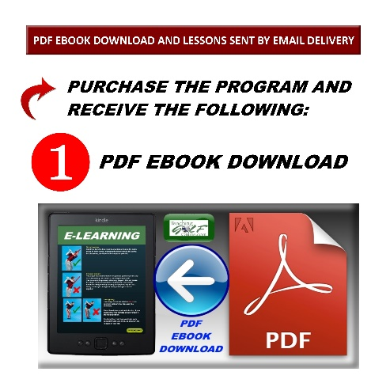
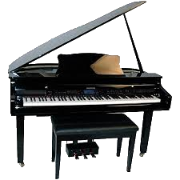
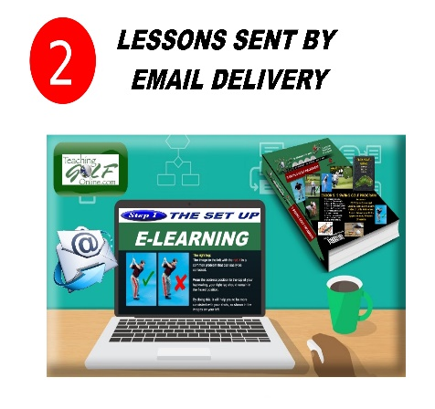
MY BUSINESS REFLEcts MY WEBSITE NAME. TEACHING GOLF ONLINE.COM IS my website offering a STEP BY STEP HOME LEARNING GOLF PROGRAM.
I have always believed that if you can take PIANO lessonS online, you should also be able to take golf lessons online.
My program includes the following:
Access to interactive ebooks that covers the entire program;
Golf lessons sent via email delivery to your inbox every 2 days; and
Accessible on all devices (computer, phone and tablet).

Slide 6
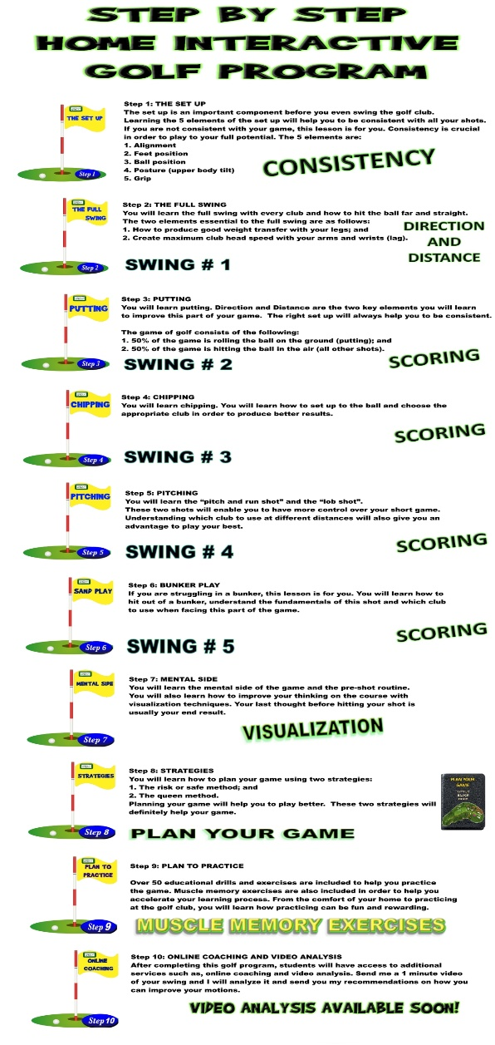
Over 20 hours of golf instructions are provided, including images, videos, educational drills and exercises for anyone to learn within the comfort of their home or at their golf facility.
Over 20 lessons will be sent to you, 1 lesson every 2 days. Every lesson is approximately 1 hour in length including images, videos, educational drills and exercises.
Step by Step Learning:
Step 1: The Set up;
Step 2: Swing 1: The Full Swing;
Step 3,4,5,6: The other 4 swings. Putting, Chipping, Pitching and Bunker Play;
Step 7: Mental Side;
Step 8: Strategies;
Step 9: Plan to practice; and
Step 10: Coaching (Video Analysis…)
KNOWLEDGE IS POWER

Slide 7
PURCHASE THE “5 SWING GOLF PROGRAM”
ONLINE, AS A GIFT FOR YOURSELF OR A FRIEND AT MY WEBSITE CALLED:
WWW.TEACHINGGOLFONLINE.COM.
THIS GIFT OF GOLF WILL BE SENT, BY EMAIL DELIVERY, TO YOURSELF OR A FRIEND ON YOUR BEHALF.

Slide 8
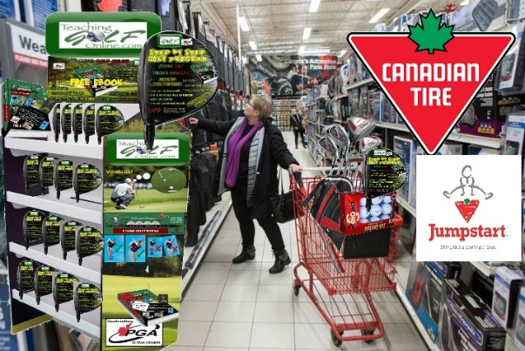
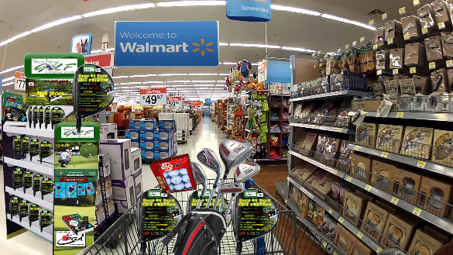
PURCHASING IN STORES
WHY NOT PURCHASE THE STEP BY STEP HOME GOLF PROGRAM AT CANADIAN TIRE, WALMART OR OTHER
SPORTING STORES?
An access gift card has an inside code, in order to activate the golf lesson program online.
(MORE PEOPLE WOULD LEARN = MORE PEOPLE WOULD PLAY = MORE PEOPLE WOULD PURCHASE = MORE REVENUES FOR ALL GOLF CLUBS).
THIS WOULD BE A WIN WIN SITUATION ALL THE WAY AROUND.

Slide 9
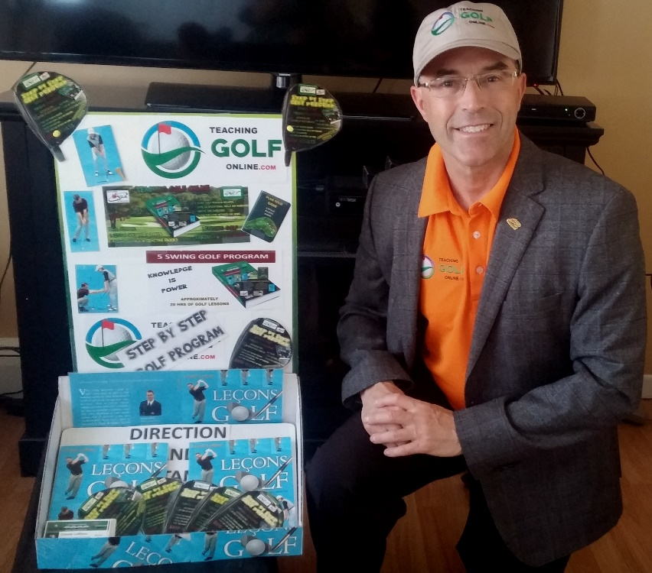
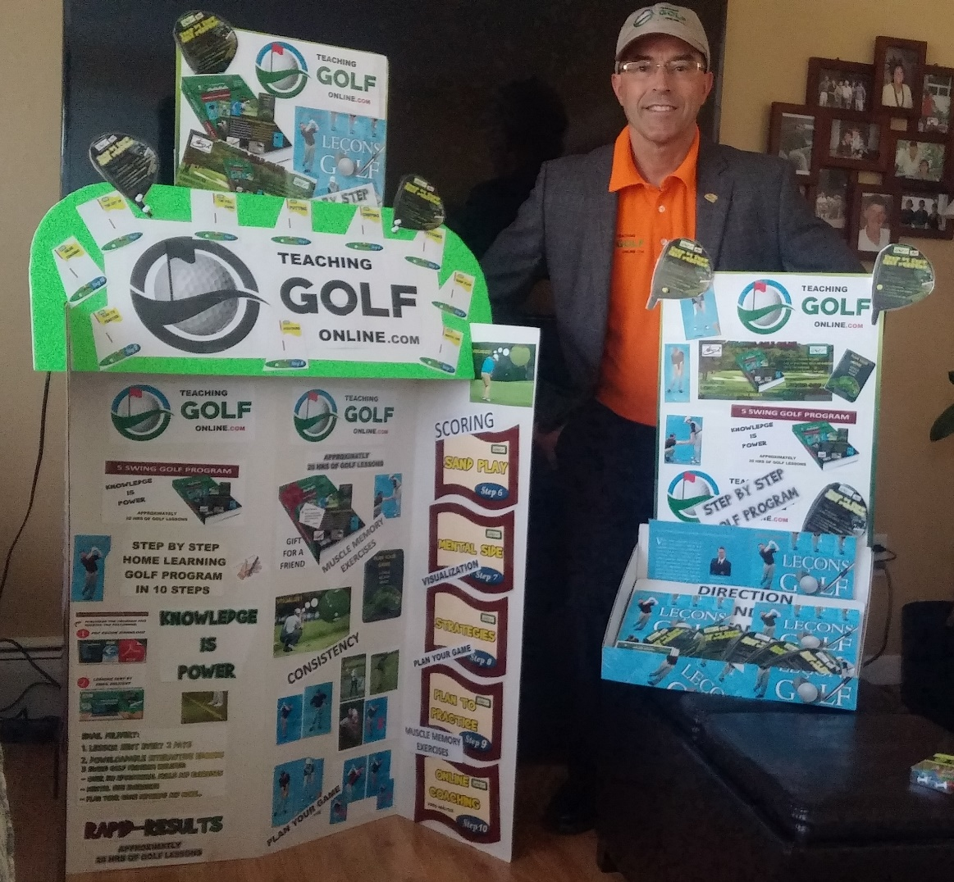
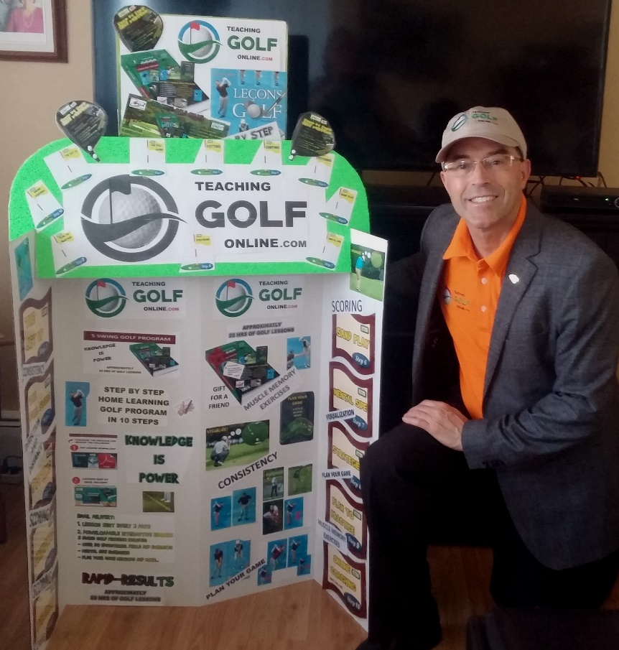
PURCHASING IN STORES

Slide 10
TEACHING THE DRAGONS:
Three different topics with CONSISTENCY being a priority, will be presented to the DRAGONS. These three topics will definitely improve the skills of any golfer, at any level. I will try to cover as much as possible with the time allotted. TOTAL: ? MIN.
The set up: I will focus primarily on POSTURE. This will help with CONSISTENCY;
The full swing: Maintain the PROPER POSTURE for CONSISTENCY (Swing #1); and
Putting; DISTANCE, DIRECTION AND CONSISTENCY (Swing #2).

Slide 11
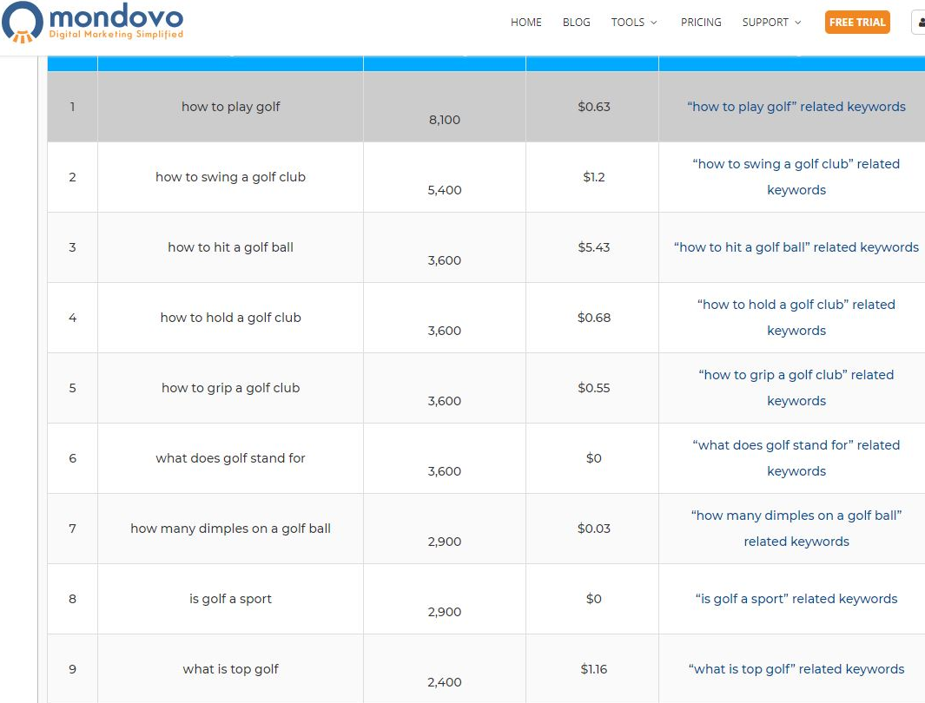
Online Search
People searching on Google for golf lessons?:
- 8000 people per month
People searching on youtube for golf tips?:
Nearly 2 million a month
536 000 results

Slide 12
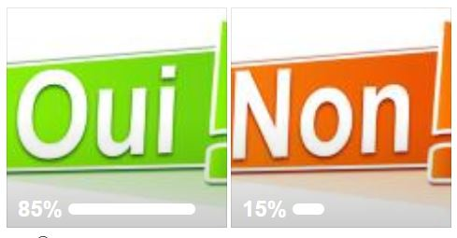
Facebook French Survey:
Bonjour les amis Facebook:
J'ai besoin de votre aide avec ce sondage. S'IL VOUS PLAÎT LIRE LES INFORMATIONS ET RÉPONDRE AUX QUESTIONS CI-DESSOUS ET PARTAGER AVEC TOUS VOS AMIS.
Pour ceux qui ne le savent pas, je présente mon projet «Teaching Golf Online» sur Dragons Den le 5 mai 2018, à Toronto. J'ai eu cette idée depuis plus de 19 ans maintenant, j'ai créé un site il y a 15 ans mais à cette époque, les sites Web étaient relativement nouveaux et très chers à créer. Recevoir des leçons de golf par courriel avec un accès automatisé était très difficile à produire et la vitesse de l'Internet n'était pas ce qu'elle est aujourd'hui. J'étais en avance sur mon temps mais maintenant je sais que c'est le bon moment et ça va marcher. Je crois qu'aujourd'hui nous sommes prêts à apprendre en ligne. Si vous pouvez apprendre à jouer du piano en ligne, vous devriez aussi être capable d'apprendre à jouer au golf. Mon programme compte environ 20 heures de leçons de golf livrées en deux formats. Après l'achat du programme, vous recevrez ce qui suit: 1. Interactive PDF Ebook avec plus de 150 pages d'informations avec des images, des vidéos, des liens et plus de 50 exercices éducatifs et des exercices que vous pouvez pratiquer dans votre maison ou sur le parcours. 2. Livraison de la leçon par courriel, une leçon arrivera dans votre boîte de réception tous les 2 jours pour que vous puissiez voir, apprendre et appliquer ces exercices pour améliorer vos compétences de golf. Mon marché est d'amener de nouveaux golfeurs au jeu. Saviez-vous que le Canada compte environ 6 millions de golfeurs? Il y a aussi environ 1,3 million de personnes, chaque année, intéressées à apprendre le golf pour la première fois et 1,3 million de personnes, chaque année, quittent le jeu. À mon avis, je crois qu'ils quittent le jeu en raison d'un manque de connaissances sur les techniques de golf. Le golf est le sport le plus pratiqué au Canada par rapport au hockey et au soccer. L'année dernière, près de 60 millions de parties de golf ont été jouées au Canada. Je peux voir mon programme de golf dans des magasins comme Walmart, Canadian Tire et des magasins de sport. Je crois fermement que si nous voulons attirer de nouveaux joueurs de golf, des leçons comme celles-ci doivent être accessibles à tous dans des endroits plus éloignés des terrains de golf.
Lors de l'achat du programme, vous achèteriez une carte-cadeau. En ouvrant cette carte-cadeau, vous auriez mon adresse de site Web (teachinggolfonline.com) et en plaçant votre code d'accès sur mon site Web, vous seriez activé sur mon site. Votre première leçon de golf envoyée par e-mail arrivera dans quelques minutes. L'automatisation interviendrait et tous les 2 jours, vous recevriez votre prochaine leçon de golf. Assez dit, j'ai besoin de votre aide en répondant à la question suivante.
1) Achèteriez-vous un programme de golf tel que celui expliqué ci-dessus si vous vouliez apprendre le jeu?

Slide 13
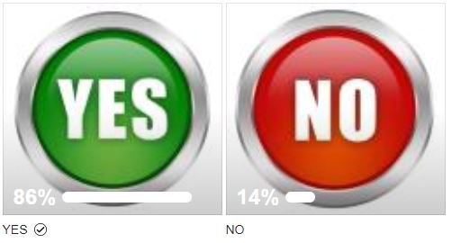
Facebook English Survey:
Hello Facebook Friends:
I NEED YOUR HELP WITH THIS SURVEY. PLEASE READ THE INFORMATION AND ANSWER THE QUESTIONS BELOW AND SHARE WITH ALL YOUR FRIENDS. For the ones who are not aware, I am presenting my project which is “Teaching Golf Online” on Dragons Den on May 5, 2018, in Toronto. I have had this idea for more than 19 years now, created a website 15 years ago but at that time, websites were fairly new and very expensive to create. Receiving golf lessons via email with automation access was very difficult to produce and the speed of the internet was not what it is today. I was ahead of my time but now I know this is the right time and this will work. I believe that today we are ready to learn online. If you can learn how to play piano online, you should be able to learn how to play golf, as well. My program has approximately 20 hours of golf lessons delivered in two formats. After purchasing the program, you will receive the following: 1. Interactive PDF Ebook with over 150 pages of information with images, videos, links and over 50 educational drills and exercises you can practice in your home or at the course. 2. Email lesson delivery, one lesson will arrive in your inbox every 2 days for you to view, learn and apply these exercises to improve your golf skills. My market is to bring new golfers to the game. Did you know that Canada has approximately 6 million golfers? There is also approximately 1.3 million people, every year, interested in learning the game of golf for the first time and 1.3 million people, every year, leaving the game. In my opinion, I believe they are leaving the game due to lack of knowledge on the techniques of golf. Golf is the most played sport in Canada over hockey and soccer. Last year, close to 60 million rounds of golf were played in Canada. I can see my golf program in stores such as Walmart, Canadian Tire and sport stores. I strongly believe that if we want to attract new golf players, lessons such as these must be available to everyone in more locations outside the golf courses.
When purchasing the program, you would actually purchase a gift card. When opening this gift card, you would have my website address (teachinggolfonline.com) and by placing your access code on my website, you would be activated on my site. Your first golf lesson sent via email will arrive within a few minutes. Automation would kick in and every 2 days, you would receive your next golf lesson. Enough said, I NEED YOUR HELP BY ANSWERING THE FOLLOWING QUESTION.
1) Would you buy a golf program such as the one explained above if you wanted to learn the game?

Slide 14
NAGA STUDY:
CLICK HERE
CLICK HERE

